Slide 1
COMP9024: Data Structures and Algorithms
Text Processing

Slide 2
Contents
Pattern matching
Tries
Greedy method
Text compression
Dynamic programming

Slide 3
Pattern Matching

Slide 4
Strings
A string is a sequence of characters
Examples of strings:
Java program
HTML document
DNA sequence
Digitized image
An alphabet Σ is the set of possible characters for a family of strings
Example of alphabets:
ASCII
Unicode
{0, 1}
{A, C, G, T}
Let P be a string of size m
A substring P[i .. j] of P is the subsequence of P consisting of the characters with ranks between i and j
A prefix of P is a substring of the type P[0 .. i]
A suffix of P is a substring of the type P[i ..m − 1]
Given strings T (text) and P (pattern), the pattern matching problem consists of finding a substring of T equal to P
Applications:
Text editors
Search engines
Biological research

Slide 5
Brute-Force Pattern Matching
The brute-force pattern matching algorithm compares the pattern P with the text T for each possible shift of P relative to T, until either
a match is found, or
all placements of the pattern have been tried
Brute-force pattern matching runs in time O(nm)
Example of worst case:
T = aaa … ah
P = aaah
may occur in images and DNA sequences
unlikely in English text
Algorithm BruteForceMatch(T, P)
Input text T of size n and pattern
P of size m
Output starting index of a substring of
T equal to P or −1 if no such
substring exists
{ for ( i = 0; i < n − m+1; i++ )
{ // test shift i of the pattern
j = 0;
while ( j < m ∧ T[i + j] = P[j] )
j = j + 1;
if ( j = m )
return i; // match at i
}
return -1 // no match anywhere
}

Slide 6
Boyer-Moore Heuristics
The Boyer-Moore’s pattern matching algorithm is based on two heuristics
Looking-glass heuristic: Compare P with a subsequence of T moving backwards
Character-jump heuristic: When a mismatch occurs at T[i] = c
If P contains c, shift P to align the last occurrence of c in P with T[i]
Else, shift P to align P[0] with T[i + 1]
Example

Slide 7
Last-Occurrence Function
Boyer-Moore’s algorithm preprocesses the pattern P and the alphabet Σ to build the last-occurrence function L mapping Σ to integers, where L(c) is defined as
the largest index i such that P[i] = c or
−1 if no such index exists
Example:
Σ = {a, b, c, d}
P = abacab
The last-occurrence function can be represented by an array indexed by the numeric codes of the characters
The last-occurrence function can be computed in time O(m + s), where m is the size of P and s is the size of Σ
c | a | b | c | d
L(c) | 4 | 5 | 3 | −1

Slide 8
The Boyer-Moore Algorithm
Algorithm BoyerMooreMatch(T, P, Σ)
{ L = lastOccurenceFunction(P, Σ )
i = m − 1
j = m − 1
repeat
if ( T[i] = P[j] )
{ if ( j = 0 )
return i // match at i
else
{ i = i − 1;
j = j − 1; }
}
else // character-jump
{ l = L[T[i]];
i = i + m – min(j, 1 + l);
j = m − 1; }
until ( i > n − 1)
return −1 // no match
}
Case 1: j ≤ 1 + l
Case 2: 1 + l ≤ j

Slide 9
Example

Slide 10
Analysis
Boyer-Moore’s algorithm runs in time O(nm + s)
Example of worst case:
T = aaa … a
P = baaa
The worst case may occur in images and DNA sequences but is unlikely in English text
Boyer-Moore’s algorithm is significantly faster than the brute-force algorithm on English text

Slide 11
The KMP Algorithm
Knuth-Morris-Pratt’s algorithm compares the pattern to the text in left-to-right, but shifts the pattern more intelligently than the brute-force algorithm.
When a mismatch occurs, what is the most we can shift the pattern so as to avoid redundant comparisons?
Answer: the largest prefix of P[0..j-1] that is a suffix of P[1..j-1]
.
.
a
b
a
a
b
x
.
.
.
.
.
a
b
a
a
b
a
j
a
b
a
a
b
a
No need to
repeat these
comparisons
Resume
comparing
here

Slide 12
KMP Failure Function
Knuth-Morris-Pratt’s algorithm preprocesses the pattern to find matches of prefixes of the pattern with the pattern itself
The failure function F(j) is defined as the size of the largest prefix of P[0..j] that is also a suffix of P[1..j]
Knuth-Morris-Pratt’s algorithm modifies the brute-force algorithm so that if a mismatch occurs at P[j] ≠ T[i] we set j ← F(j − 1)
j | 0 | 1 | 2 | 3 | 4 | 5
P[j] | a | b | a | a | b | a
F(j) | 0 | 0 | 1 | 1 | 2 | 3

Slide 13
The KMP Algorithm (1/2)
Algorithm KMPMatch(T, P)
{ F = failureFunction(P);
i = 0;
j = 0;
while ( i < n )
if ( T[i] = P[j] )
{ if ( j = m − 1 )
return i − j ; // match
else
{ i = i + 1; j = j + 1;}
}
else
if ( j > 0 )
j = F[j − 1];
else
i = i + 1;
return −1; // no match
}

Slide 14
The KMP Algorithm (2/2)
The failure function can be represented by an array and can be computed in O(m) time
At each iteration of the while-loop, either
i increases by one, or the shift amount i − j increases by at least one (observe that F(j − 1) < j)
Consider that the loop body is executed 2n times. Since the initial values of both i and j are 0, we have i + i-j ≥ 2n after 2n iterations. Therefore, 2i ≥ 2n+j and i ≥ n+j/2. Since j is at least 0, i ≥ n holds, which means the loop must terminate after 2n iterations.
Hence, there are no more than 2n iterations of the while-loop
Thus, KMP’s algorithm runs in optimal time O(m + n)

Slide 15
Computing the Failure Function
Algorithm failureFunction(P)
{ F[0] = 0;
i = 1;
j = 0;
while ( i < m )
if ( P[i] = P[j] )
{ // we have matched j + 1 char
F[i] = j + 1;
i = i + 1;
j = j + 1; }
else if ( j > 0 )
// use failure function to shift P
j = F[j − 1];
else
{ F[i] = 0; // no match
i = i + 1;}
}
The failure function can be represented by an array and can be computed in O(m) time
The construction is similar to the KMP algorithm itself
At each iteration of the while-loop, either
i increases by one, or
the shift amount i − j increases by at least one (observe that F(j − 1) < j)
Hence, there are no more than 2m iterations of the while-loop

Slide 16
Example
j | 0 | 1 | 2 | 3 | 4 | 5
P[j] | a | b | a | c | a | b
F(j) | 0 | 0 | 1 | 0 | 1 | 2

Slide 17
Tries

Slide 18
Preprocessing Strings
Preprocessing the pattern speeds up pattern matching queries
After preprocessing the pattern, KMP’s algorithm performs pattern matching in time proportional to the text size
If the text is large, immutable and searched for often (e.g., works by Shakespeare), we may want to preprocess the text instead of the pattern
A trie is a compact data structure for representing a set of strings, such as all the words in a text
A tries supports pattern matching queries in time proportional to the pattern size

Slide 19
Standard Tries
The standard trie for a set of strings S is an ordered tree such that:
Each node but the root is labeled with a character
The children of a node are alphabetically ordered
The paths from the external nodes to the root yield the strings of S
Example: standard trie for the set of strings
S = { bear, bell, bid, bull, buy, sell, stock, stop }

Slide 20
Analysis of Standard Tries
A standard trie uses O(n) space and supports searches, insertions and deletions in time O(dm), where:
n total size of the strings in S
m size of the string parameter of the operation
d size of the alphabet

Slide 21
Word Matching with a Trie
We insert the words of the text into a trie
Each leaf stores the occurrences of the associated word in the text

Slide 22
Compressed Tries
A compressed trie has internal nodes of degree at least two
It is obtained from standard trie by compressing chains of “redundant” nodes

Slide 23
Compact Representation
Compact representation of a compressed trie for an array of strings:
Stores at the nodes ranges of indices instead of substrings
Uses O(s) space, where s is the number of strings in the array
Serves as an auxiliary index structure

Slide 24
Suffix Trie
The suffix trie of a string X is the compressed trie of all the suffixes of X

Slide 25
Pattern Matching Using Suffix Trie (1/2)
Algorithm suffixTrieMatch(T, P)
{ p = P.length; j = 0; v = T.root();
repeat
{ for each child w of v do
{ // we have matched j + 1 char
childTraversed=false; i = start(w); // start(w) is the start index of w
if ( P[j] = X[i] ) // process child w
{ childTraversed=true;
x = end(w) − i +1; // end(w) is the end index of w
if ( p ≤ x )
// suffix is shorter than or of the same length of the node label
{ if ( P[j:j+p−1] = X[i:i+p−1] ) return i – j ;
else return “P is not a substring of X” ; }
else // the pattern goes beyond the substring stored at w
{ if ( P[j:j+x−1] = X[i:i+x−1] )
{ p = p − x; // update suffix length
j = j + x; // update suffix start index
v = w; break ; }
else return “P is not a substring of X” ; }}}}
until childTraversed=false or T.isExternal(v);
return “P is not a substring of X” ; }

Slide 26
Pattern Matching Using Suffix Trie (2/2)
Input of the algorithm:
Compact suffix trie T for a text X and pattern P.
Output of the algorithm:
Starting index of a substring of X matching P or an indication that P is not a substring.
The algorithm assumes the following additional property on the labels of the nodes in the compact representation of the suffix trie:
If node v has label (i, j) and Y is the string of length y associated with the path from the root to v (included), then X[j-y+1..j]=Y.
This property ensures that we can easily compute the start index of the pattern in the text when a match occurs.

Slide 27
Analysis of Suffix Tries
Compact representation of the suffix trie for a string X of size n from an alphabet of size d
Uses O(n) space
Supports arbitrary pattern matching queries in X in O(dm) time, where m is the size of the pattern
Can be constructed in O(n) time

Slide 28
Greedy Method and Text Compression

Slide 29
The Greedy Method Technique
The greedy method is a general algorithm design paradigm, built on the following elements:
configurations: different choices, collections, or values to find
objective function: a score assigned to configurations, which we want to either maximize or minimize
It works best when applied to problems with the greedy-choice property:
a globally-optimal solution can always be found by a series of local improvements from a starting configuration.

Slide 30
Text Compression
Given a string X, efficiently encode X into a smaller string Y
Saves memory and/or bandwidth
A good approach: Huffman encoding
Compute frequency f(c) for each character c.
Encode high-frequency characters with short code words
No code word is a prefix for another code
Use an optimal encoding tree to determine the code words

Slide 31
Encoding Tree Example
A code is a mapping of each character of an alphabet to a binary code-word
A prefix code is a binary code such that no code-word is the prefix of another code-word
An encoding tree represents a prefix code
Each external node stores a character
The code word of a character is given by the path from the root to the external node storing the character (0 for a left child and 1 for a right child)
00 | 010 | 011 | 10 | 11
a | b | c | d | e
a
d
e
b
c

Slide 32
Encoding Tree Optimization
Given a text string X, we want to find a prefix code for the characters of X that yields a small encoding for X
Frequent characters should have short code-words
Rare characters should have long code-words
Example
X = abracadabra
T₁ encodes X into 29 bits
T₂ encodes X into 24 bits
T₁
T₂
c
d
b
a
b
r
a
r
c
d

Slide 33
Huffman’s Algorithm
Given a string X, Huffman’s algorithm construct a prefix code the minimizes the size of the encoding of X
It runs in time O(n + d log d), where n is the size of X and d is the number of distinct characters of X
A heap-based priority queue is used as an auxiliary structure
Algorithm HuffmanEncoding(X)
Input string X of size n
Output optimal encoding trie for X
{
C = distinctCharacters(X);
computeFrequencies(C, X);
Q = new empty heap;
for all c ∈ C
{ T = new single-node tree storing c;
Q.insert(getFrequency(c), T); }
while ( Q.size() > 1 )
{ f₁ = Q.minKey();
T₁ = Q.removeMin();
f₂ = Q.minKey();
T₂ = Q.removeMin();
T = join(T₁, T₂);
Q.insert(f₁ + f₂, T);
}
return Q.removeMin();
}

Slide 34
Example
11
X = abracadabra
a
6
Frequencies
2
4
a | b | c | d | r
5 | 2 | 1 | 1 | 2
c
d
b
r
6
2
4
a
b
c
d
r
5
2
1
1
2
a
c
d
b
r
5
2
2
4
a
b
c
d
r
a
c
d
b
r
5
2
2
5

Slide 35
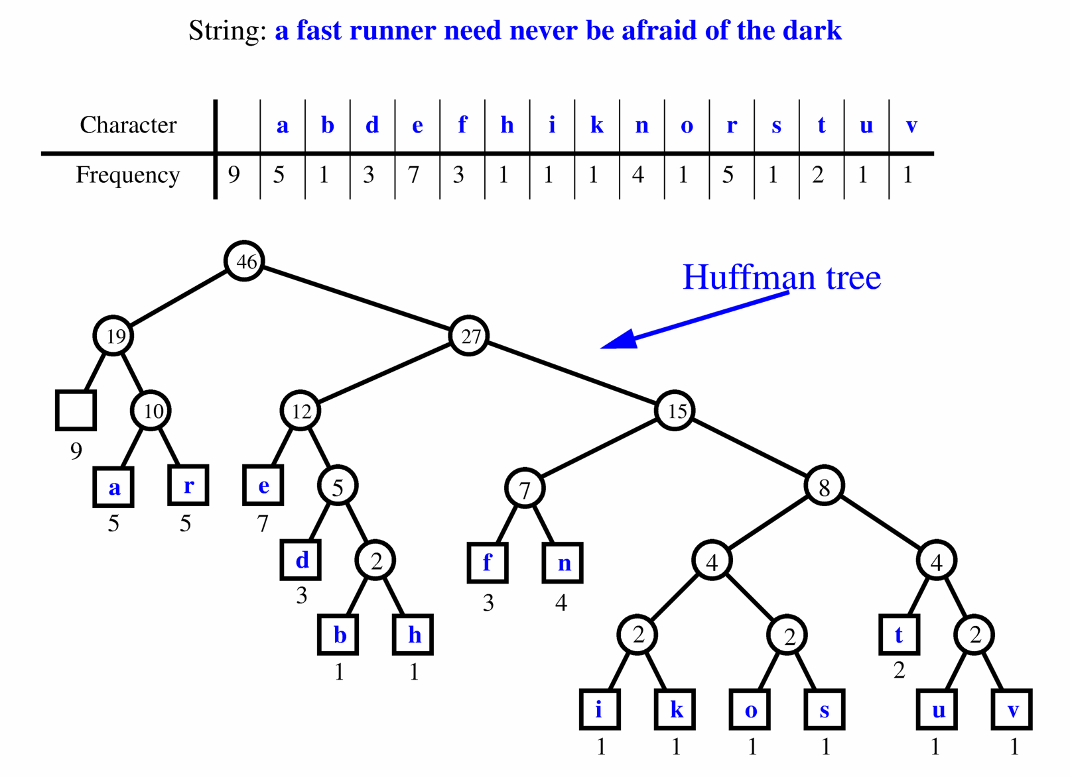
Extended Huffman Tree Example

Slide 36
The Fractional Knapsack Problem
Given: A set S of n items, with each item i having
b_{i} - a positive benefit
w_{i} - a positive weight
Goal: Choose items with maximum total benefit but with weight at most W.
If we are allowed to take fractional amounts, then this is the fractional knapsack problem.
In this case, we let x_{i} denote the amount we take of item i
Objective: maximize
Constraint:

Slide 37
Example
Given: A set S of n items, with each item i having
b_{i} - a positive benefit
w_{i} - a positive weight
Goal: Choose items with maximum total benefit but with weight at most W.
“knapsack”
Solution:
1 ml of 5
2 ml of 3
6 ml of 4
1 ml of 2
Items:
1
2
3
4
5
Weight:
4 ml
8 ml
2 ml
6 ml
1 ml
Benefit:
$12
$32
$40
$30
$50
Value:
3
4
20
5
50
10 ml
($ per ml)

Slide 38
The Fractional Knapsack Algorithm
Greedy choice: Keep taking item with highest value (benefit to weight ratio)
Since
Run time: O(n log n). Why?
Correctness: Suppose there is a better solution
there is an item i with higher value than a chosen item j, but x_{i}<w_{i}, x_{j}>0 and v_{i}<v_{j}
If we substitute some i with j, we get a better solution
How much of i: min{w_{i}-x_{i}, x_{j}}
Thus, there is no better solution than the greedy one
Algorithm fractionalKnapsack(S, W)
Input: set S of items with benefit b_{i} and weight w_{i}; max. weight W Output: amount x_{i} of each item i to maximize benefit with weight at most W
{ for each item i in S
{ x_{i} = 0;
v_{i} = b_{i} / w_{i} ; // value
}
w = 0; // total weight
while ( w < W )
{ remove item i with highest v_{i}
x_{i} = min{w_{i} , W - w};
w = w + min{w_{i} , W - w};
}
}

Slide 39
Task Scheduling
Given: a set T of n tasks, each having:
A start time, s_{i}
A finish time, f_{i} (where s_{i} < f_{i})
Goal: Perform all the tasks using a minimum number of “machines.”
Machine 3
Machine 2
Machine 1
1
2
3
4
5
6
7
8
9

Slide 40
Task Scheduling Algorithm
Greedy choice: consider tasks by their start time and use as few machines as possible with this order.
Run time: O(n log n). Why?
Correctness: Suppose there is a better schedule.
We can use k-1 machines
The algorithm uses k
Let i be first task scheduled on machine k
Machine i must conflict with k-1 other tasks
But that means there is no non-conflicting schedule using k-1 machines
Algorithm taskSchedule(T)
Input: set T of tasks with start time s_{i} and finish time f_{i}
Output: non-conflicting schedule with minimum number of machines
{ m = 0; // no. of machines
while T is not empty
{ remove task i with smallest s_{i}
if there’s a machine j for i then
schedule i on machine j ;
else
{ m = m + 1;
schedule i on machine m;
}
}
}

Slide 41
Example
Given: a set T of n tasks, each having:
A start time, s_{i}
A finish time, f_{i} (where s_{i} < f_{i})
[1,4], [1,3], [2,5], [3,7], [4,7], [6,9], [7,8] (ordered by start)
Goal: Perform all tasks on min. number of machines
Machine 3
Machine 2
Machine 1
1
2
3
4
5
6
7
8
9

Slide 42
Dynamic Programming

Slide 43
Divide and Conquer (1/2)
A problem-solving strategy in computer science
Basic idea:
Decompose a given problem into one or more subproblems
Solve the subproblems in turn
Combine the solutions to the subproblems into the solution to the given problem.
If subproblems are of the same structures as the given problem, we can use recursion to solve the given problem

Slide 44
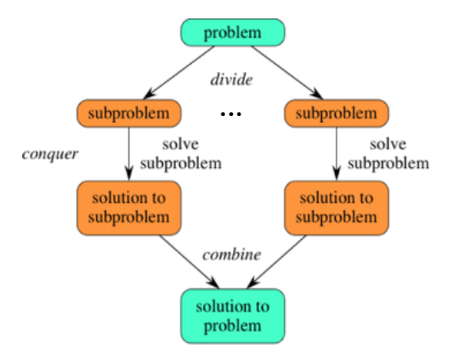
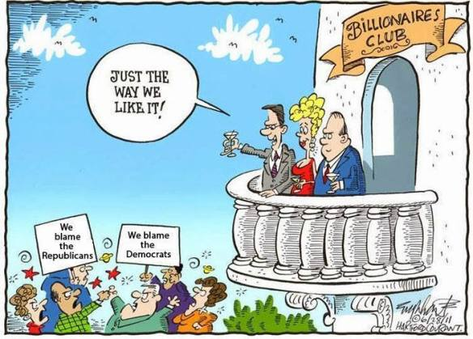
Divide and Conquer (2/2)
Taken from https://tellingthetruth1993.com/2018/03/02/the-divide-and-conquer-club/

Slide 45
Key Ideas with Dynamic Programming (1/2)
When applying recursion to solve a problem, if subproblems do not overlap, recursions will be efficient. Otherwise, recursions may lead to exponential time complexity (recall the recursive function for Fibonacci numbers)
When subproblems overlap, we find an optimal way for solving the problem to eliminate redundant computation
Solve all the problems (smallest problems) at the lowest level, and proceed to solve all the subproblems at the next level until the given problem is solved.

Slide 46
Key Ideas with Dynamic Programming (2/2)
Algorithm BinaryFib(k)
{ Input : Nonnegative integer k
Output : The kth Fibonacci number Fk
if ( k =0 or 1) return k;
else
return BinaryFib(k - 1) + BinaryFib(k - 2);
}
Fib(4)
Level 3
Fib(4)
Fib(3)
Level 2
Fib(3)
Fib(2)
Fib(2)
Level 1
Fib(2)
Fib(1)
Fib(1)
Fib(0)
Level 0
Fib(1)
Fib(0)
Fib(1)
Fib(0)

Slide 47
Matrix Chain-Products
Review: Matrix Multiplication.
C = A*B
A is d × e and B is e × f
O(def ) time
f
B
j
e
e
A
C
d
i
i,j
d
f

Slide 48
Matrix Chain-Products
Matrix Chain-Product:
Compute A=A₀*A₁*…*A_{n-1}
A_{i} is d_{i} × d_{i+1}
Problem: How to parenthesize?
Example
B is 3 × 100
C is 100 × 5
D is 5 × 5
(B*C)*D takes 1500 + 75 = 1575 ops
B*(C*D) takes 1500 + 2500 = 4000 ops

Slide 49
An Enumeration Approach
Matrix Chain-Product Alg.:
Try all possible ways to parenthesize A=A₀*A₁*…*A_{n-1}
Calculate number of ops for each one
Pick the one that is best
Running time:
The number of parenthesizations is equal to the number of binary trees with n nodes
This is exponential!
It is called the Catalan number, and it is almost 4^{n}.
This is a terrible algorithm!

Slide 50
A Greedy Approach
Idea #1: repeatedly select the product that uses (up) the most operations.
Counter-example:
A is 10 × 5
B is 5 × 10
C is 10 × 5
D is 5 × 10
Greedy idea #1 gives (A*B)*(C*D), which takes 500+1000+500 = 2000 ops
A*((B*C)*D) takes 500+250+250 = 1000 ops

Slide 51
Another Greedy Approach
Idea #2: repeatedly select the product that uses the fewest operations.
Counter-example:
A is 101 × 11
B is 11 × 9
C is 9 × 100
D is 100 × 99
Greedy idea #2 gives A*((B*C)*D)), which takes 109989+9900+108900=228789 ops
(A*B)*(C*D) takes 9999+89991+89100=189090 ops
The greedy approach is not giving us the optimal value.

Slide 52
A “Recursive” Approach
Define subproblems:
Find the best parenthesization of A_{i}*A_{i+1}*…*A_{j}.
Let N_{i,j} denote the number of operations done by this subproblem.
The optimal solution for the whole problem is N_{0,n-1}.
Subproblem optimality: The optimal solution can be defined in terms of optimal subproblems
There has to be a final multiplication (root of the expression tree) for the optimal solution.
Say, the final multiply is at index i: (A₀*…*A_{i})*(A_{i+1}*…*A_{n-1}).
Then the optimal solution N_{0,n-1} is the sum of two optimal subproblems, N_{0,i} and N_{i+1,n-1} plus the time for the last multiply.
If the global optimum did not have these optimal subproblems, we could define an even better “optimal” solution.

Slide 53
A Characterizing Equation
The global optimal has to be defined in terms of optimal subproblems, depending on where the final multiply is at.
Let us consider all possible places for that final multiply:
Recall that A_{i} is a d_{i} × d_{i+1} dimensional matrix.
So, a characterizing equation for N_{i,j} is the following:
Note that subproblems are not independent--the subproblems overlap.

Slide 54
A Dynamic Programming Algorithm
Since subproblems overlap, we don’t use recursion.
Instead, we construct optimal subproblems “bottom-up.”
N_{i,i}’s are easy, so start with them
Then do length 2,3,… subproblems, and so on.
Running time: O(n³)
Algorithm matrixChain(S):
Input: sequence S of n matrices to be multiplied
Output: number of operations in an optimal parenthesization of S
{ for ( i = 1; i ≤ n-1; i++ )
N_{i,i} = 0;
for ( b = 1; b ≤ n-1; b++ )
for ( i = 0; i ≤ n-b-1; i++ )
{ j = i+b;
N_{i,j} = +infinity;
for ( k = i ; k ≤ j-1; i++ )
N_{i,j} = min{N_{i,j} , N_{i,k} +N_{k+1,j} +d_{i} d_{k+1} d_{j+1}};
}
}

Slide 55
A Dynamic Programming Algorithm Visualization
The bottom-up construction fills in the N array by diagonals
N_{i,j} gets values from pervious entries in i-th row and j-th column
Filling in each entry in the N table takes O(n) time.
Total running time: O(n³)
Getting actual parenthesization can be done by remembering “k” for each N entry
answer
N
0
1
2
j
…
n-1
0
1
…
i
n-1

Slide 56
The General Dynamic Programming Technique
Applies to a problem that at first seems to require a lot of time (possibly exponential), provided we have:
Simple subproblems: the subproblems can be defined in terms of a few variables, such as j, k, l, m, and so on.
Subproblem optimality: the global optimum value can be defined in terms of optimal subproblems
Subproblem overlap: the subproblems are not independent, but instead they overlap (hence, should be constructed bottom-up).

Slide 57
Subsequences
A subsequence of a character string x₀x₁x₂…x_{n-1} is a string of the form x_{i1}x_{i2}…x_{ik}, where ij < ij+1.
Not the same as substring!
Example String: ABCDEFGHIJK
Subsequence: ACEGIJK
Subsequence: DFGHK
Not subsequence: DAGH

Slide 58
The Longest Common Subsequence (LCS) Problem
Given two strings X and Y, the longest common subsequence (LCS) problem is to find a longest subsequence common to both X and Y
Has applications to DNA similarity testing (alphabet is {A,C,G,T})
Example: ABCDEFG and XZACKDFWGH have ACDFG as a longest common subsequence

Slide 59
A Poor Approach to the LCS Problem
A Brute-force solution:
Enumerate all subsequences of X
Test which ones are also subsequences of Y
Pick the longest one.
Analysis:
If X is of length n, then it has 2^{n} subsequences
This is an exponential-time algorithm!

Slide 60
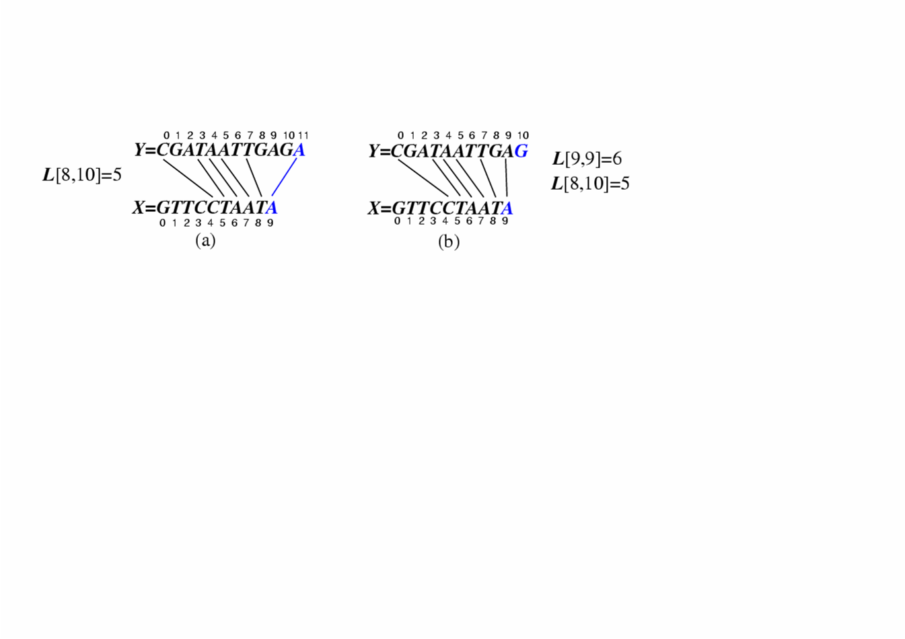
A Dynamic-Programming Approach to the LCS Problem
Define L[i,j] to be the length of the longest common subsequence of X[0..i] and Y[0..j].
Allow for -1 as an index, so L[-1,k] = 0 and L[k,-1]=0, to indicate that the null part of X or Y has no match with the other.
Then we can define L[i,j] in the general case as follows:
If x_{i}=y_{j}, then L[i,j] = L[i-1,j-1] + 1 (we can add this match)
If x_{i}≠y_{j}, then L[i,j] = max{L[i-1,j], L[i,j-1]} (we have no match here)
Case 1:
Case 2:

Slide 61
An LCS Algorithm
Algorithm LCS(X,Y ):
Input: Strings X and Y with n and m elements, respectively
Output: For i = 0,…,n-1, j = 0,...,m-1, the length L[i, j] of a longest string that is a
subsequence of both the string X[0..i] = x₀x₁x₂…x_{i} and the string Y [0.. j] = y₀y₁y₂…y_{j}
{ for ( i =-1; i ≤ n-1, i ++ )
L[i,-1] = 0;
for ( j =-1; i ≤ m-1, j ++ )
L[-1,j] = 0;
for ( i =0; i ≤ n-1, i ++ )
for ( j =0; i ≤ m-1, j ++ )
if ( x_{i} = y_{j} )
L[i, j] = L[i-1, j-1] + 1;
else
L[i, j] = max{L[i-1, j] , L[i, j-1]};
return array L;
}

Slide 62
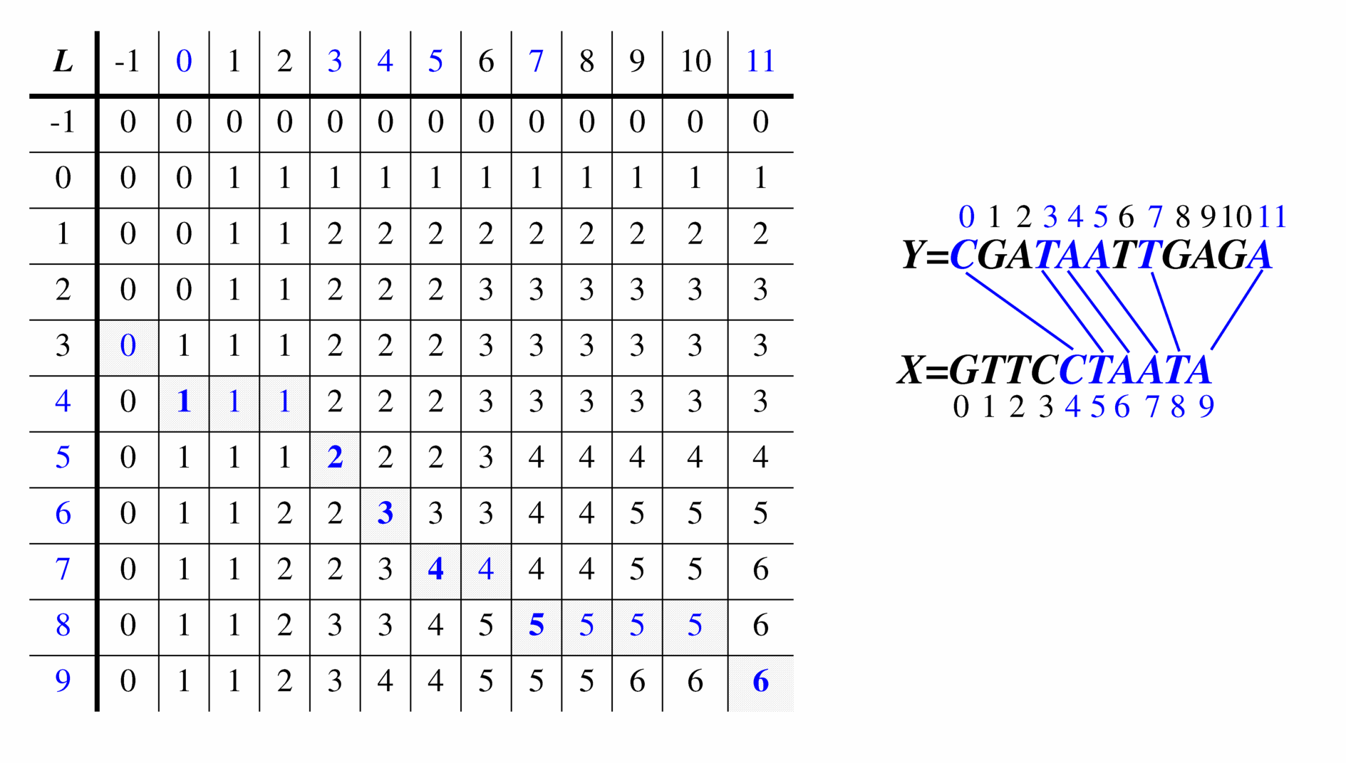
Visualizing the LCS Algorithm

Slide 63
Analysis of LCS Algorithm
We have two nested loops
The outer one iterates n times
The inner one iterates m times
A constant amount of work is done inside each iteration of the inner loop
Thus, the total running time is O(nm)
Answer is contained in L[n,m] (and the subsequence can be recovered from the L table)

Slide 64
Summary
Boyer-Moore algorithm
KMP algorithm
Standard tries
Compressed tries
Compact representation of compressed tries
Greedy method
Dynamic programming
Suggested reading:
Sedgewick, Ch. 5.3, 15.2, 15.3.

